Slide 1
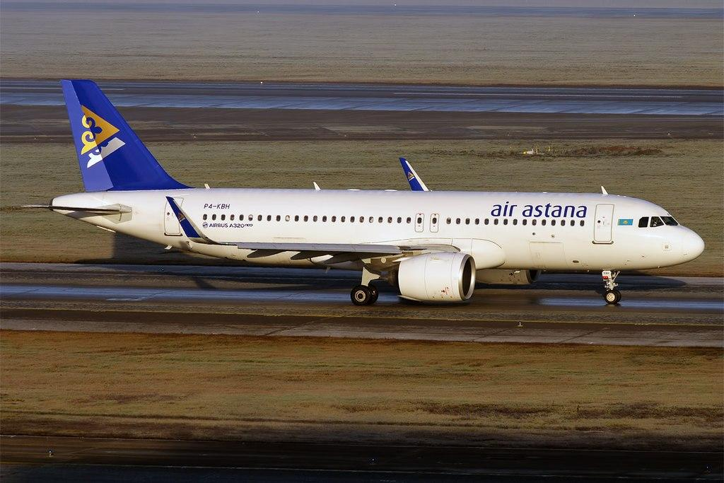
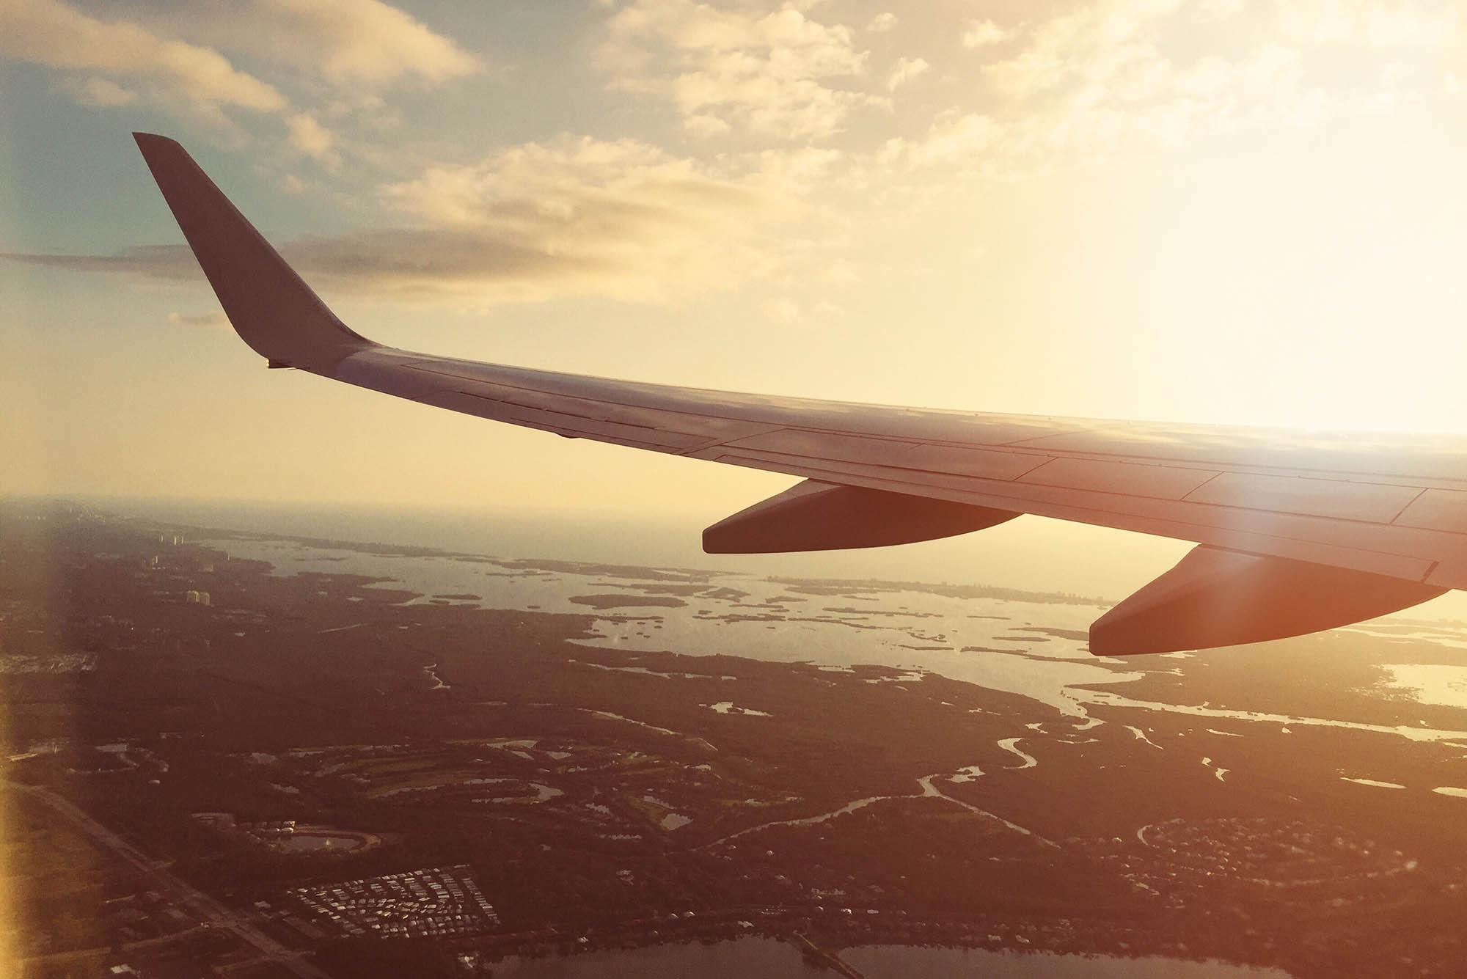

Flight Delay Avoidance
Dashboard

Slide 2
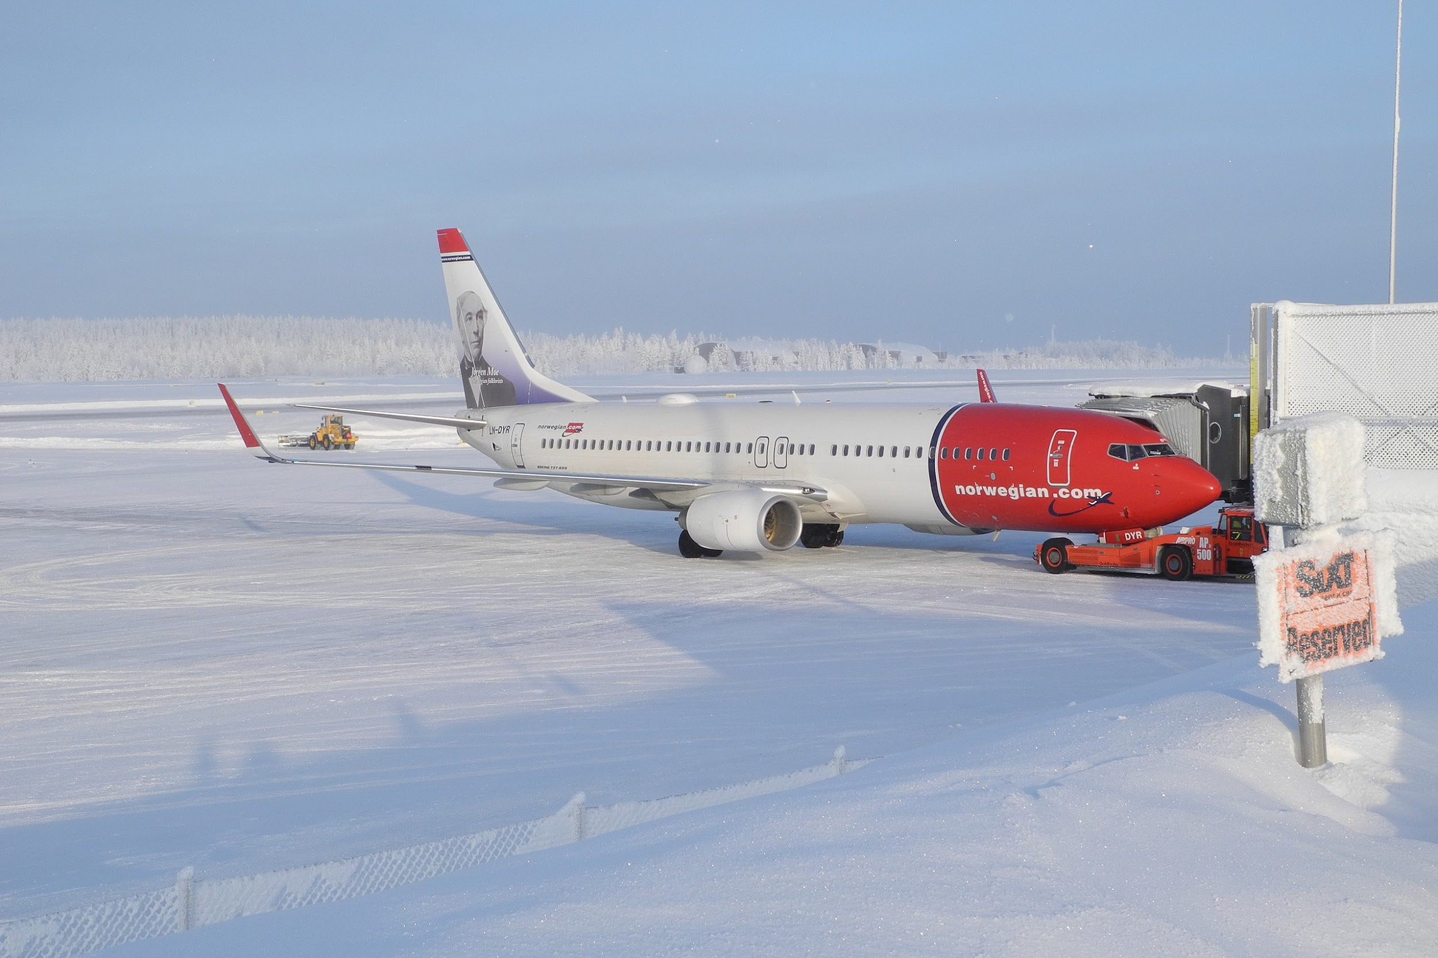
Welcome to the future of air travel
Meet our crew
Goal
Rationale
Question
Notes:
Welcome to the future of air travel.
Allow me to introduce our crew:
Tommy Williams and Daniela Gonzalez will be our database stewards, making sure our data fits neatly in the compartment overhead.
June Pui and John Pinto will be our Machine Learning pilots
My name is Hernan Cortes, and I’ll be your Tableau flight attendant, who along with Tommy, will make sure you reach your data destination hopefully without too much turbulence.
Our goal is to develop a tool that enables passengers to make travel plans that have the best probability to arrive on-time prior to purchase using specific criteria such as airline, time of day, weather, among others.
According to a 2019 study, the average cost to passengers for delays was $74 per minute. The cost to both airline carriers and passengers alike, is calculated in the $billions each year and according to a recent CNN report, contributes to passenger unruliness. Such delays can, in some cases, lead to missed connecting flights that ruin vacations or other time-sensitive events like weddings, funerals, or job interviews. Moreover as passengers make selections that favor likely on-time arrivals, they will be leveraging market forces to compel industry to make needed changes that would otherwise go unnoticed.
So the question is: what conditions are most likely to result in a flight delay or conversely an on-time arrival?

Slide 3
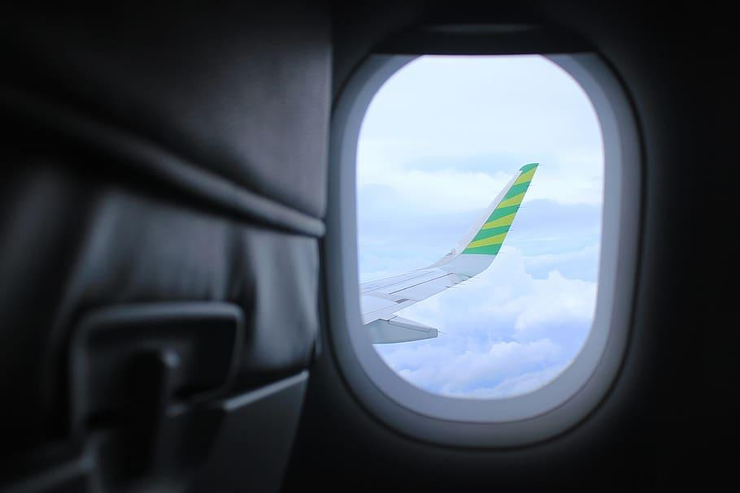
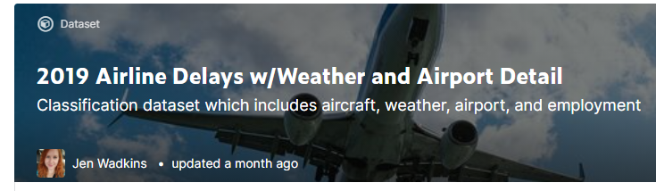
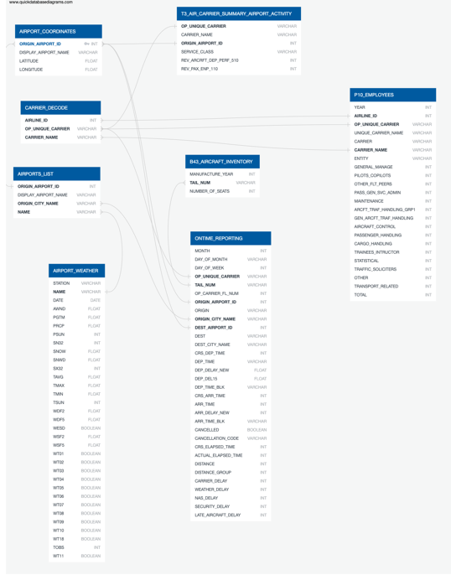
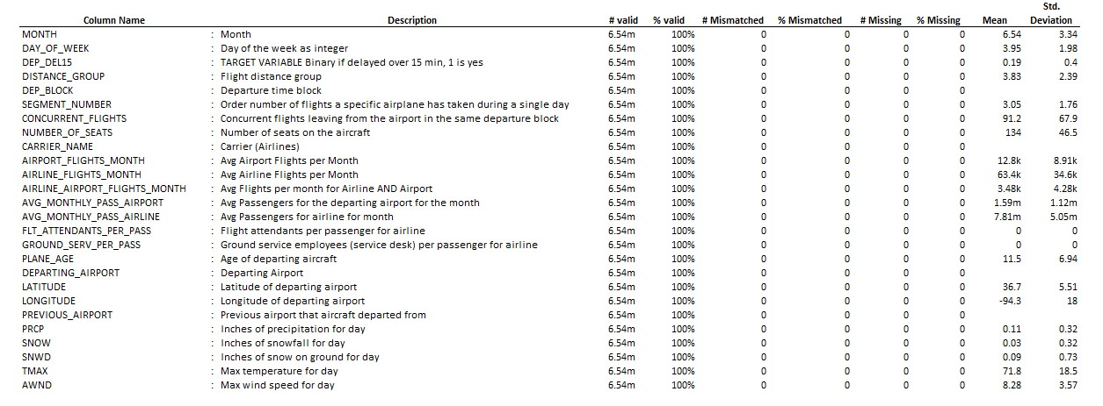
Data Description
Describing our data source
Where we obtained the data
Shape, count, data present, data limitations, what caught our eye, etc.
Notes:
To answer this question we accessed a data repository containing detailed airline, weather, airport and employment information collected from the Bureau of Transportation statistics, National Center for Environment Information (NOAA). This Flight delay data has been curated by Jen Wadkins and stored on kaggle.com and includes 24 raw data files, These files have been combined to form a single dataset consisting of 6.5 million records and 26 features. We have used R and Python to reduce these data to a smaller sample of 600k records.
The dataset was comprehensive and quite clean with the exception of a duplication of August data, mislabeled as September. This data was subsequently removed prior to systematic analysis.
Our first stop on this journey was to decide which features to initially consider.

Slide 4
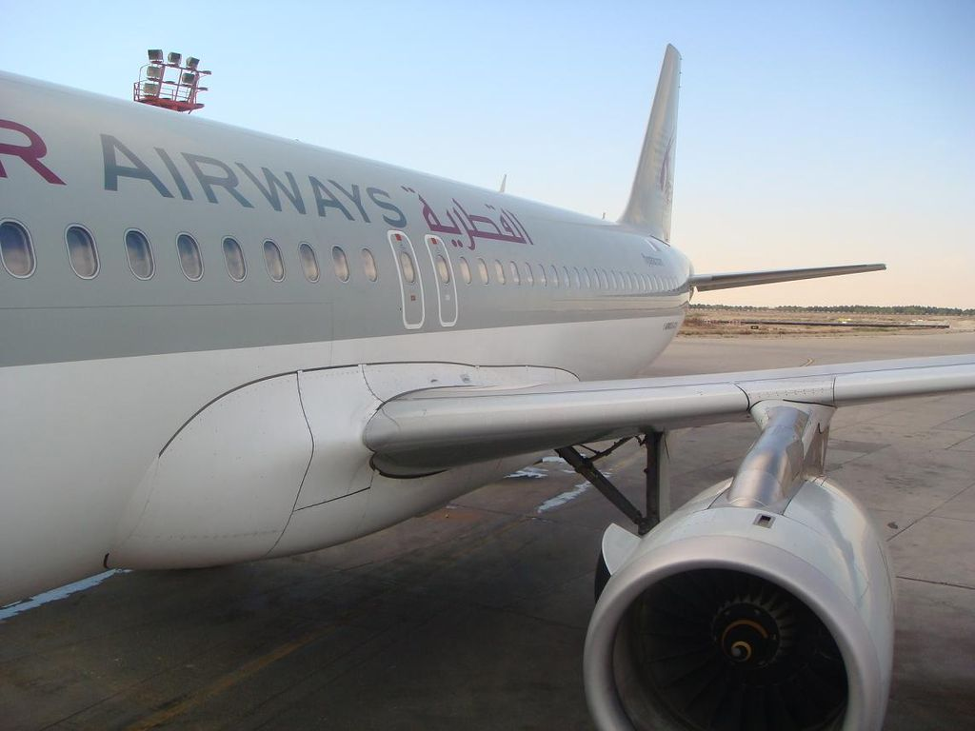
Initial Feature Selection
Month
Age of Departing Aircraft
Departure Block (time of day)
Carrier Name
Max Temp
Wind Speed
Snowfall
Precipitation
Departing Airport
Airport Flights

Slide 5







Software

Slide 6
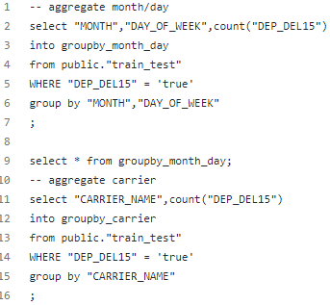
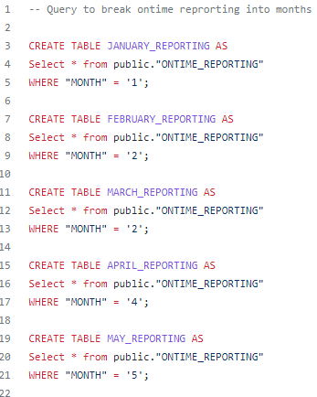
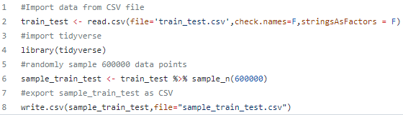
Features and Preprocessing
Features originally narrowed down from 26 to 10
EDA achieved using Tableau, Python, and pgAdmin
Preprocessing completed via use of SQL in pgAdmin to create tables for processing
RSTudio and Python used to select a random sample of data from the original 6.5 million rows
Tableau used to visualize features selected before machine learning, and most prominent features afterwards

Slide 7
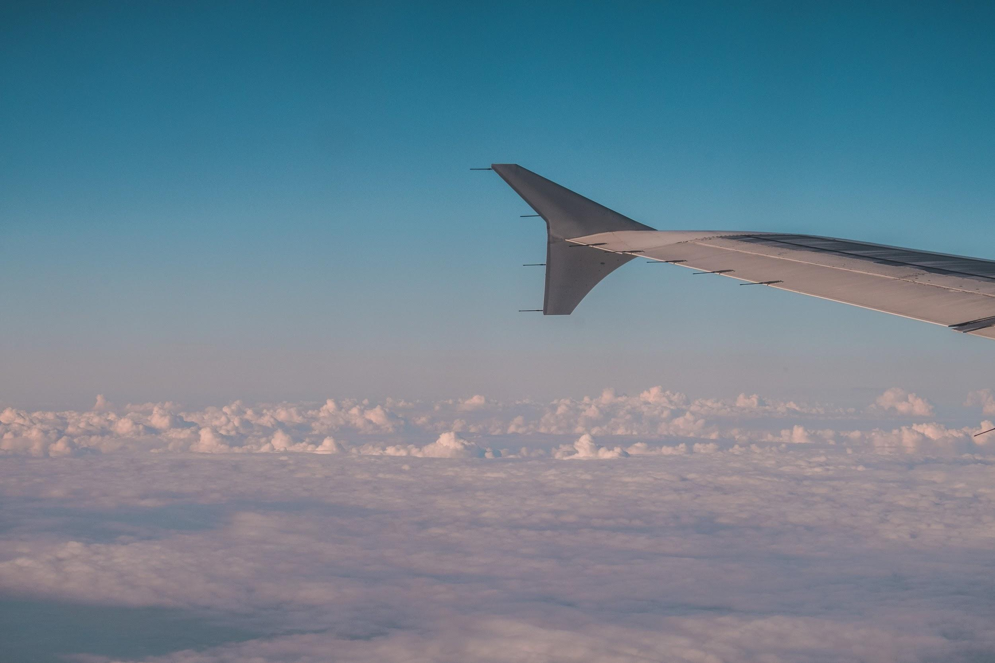
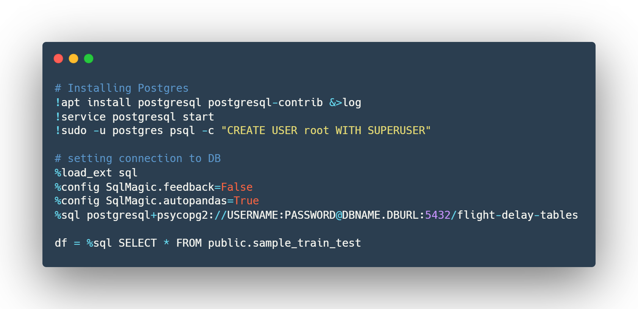
Model Selection and Data Preprocessing
Destination 1: Logistic Regression
Destination 2: SVM
Destination 3: KNN
Destination 4: Random Forest Model
Destination 5: Neural Network
Notes:
June:
Welcome aboard to the machine learning airline. I am going to go over the flights journey. Initially it was decided that a Logistic Regression and a SVM model were to be utilized since our targeted goal is to build a classification model that predict class membership. Right away we experienced two major hurdles:
For the Logistic Regression - Our results shows that our model was overfitted and so it would not be accurate in predicting delays.
For the SVM -. After consulting with the air traffic control, aka the instructional staff, scaling the data, and adjusting the kernel, the model would not fit the data even after over 6 hours of runtime. As a result of The resource limitations within Google Collab, it forced the group to drop this model choice as a viable one
Taking into account the two limitation mentioned, we decided to utilize a K-nearest Neighbor and Ensemble Random Forest model in an attempt to have more than one functional model and address the overfitting issue. The results from these models showed significant improvement in the f1 score, it jumped from a 1% in the logistic regression to 24% in both the KNN and the ensemble random forest. Further details about the scores will be explained later in the presentation.
As a final attempt to solve the overfitting issue, we attempted a Neural network model. Given the limited time availability, we were able to build a model with an 81% accuracy score but the loss score consistently sat at 47%. If given more time, we would’ve liked to continue more experimentation with this model.
John:
The data preprocessing process began by uploading all of the raw data tables to an AWS RDS database.
An efficient way to connect the Collab notebooks with the AWS database had to be implemented. This was addressed by installing a local version of Postgres in the Collab notebook and connecting to the database directly; after successfully connecting to the database, the working table was then imported into a pandas dataframe.

Slide 8

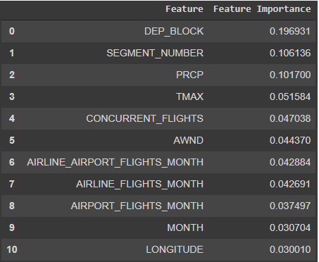
Feature Selection
Feature Ranking Example
Initial: | Month | Age of Departing Aircraft | Departure Block (time of day) | Carrier Name | Max Temp | Wind Speed | Snowfall | Precipitation | Departing Airport | Airport Flights
Actual: | Departure block | Segment Number | Concurrent Flights | Avg Flights per month for Airline AND Airport | Avg Airport Flights per Month | Precipitation | Wind Speed | Snow | Max Temp | Plane Age
Notes:
June:
As mentioned before, in the first iteration of feature selection, the data set was analyzed and 10 features were chosen arbitrarily as being most impactful. This approach was then refined in later stages of the project as it was determined that choosing features prior to model testing could lead to inherent bias and less accurate results.
As such all 26 features originally present in the data were considered in the process.
We used a combination of a tree-based estimator (i.e. random forests) and the correlation matrix to get an insight of the most influential features on the targeted variable.

Slide 9

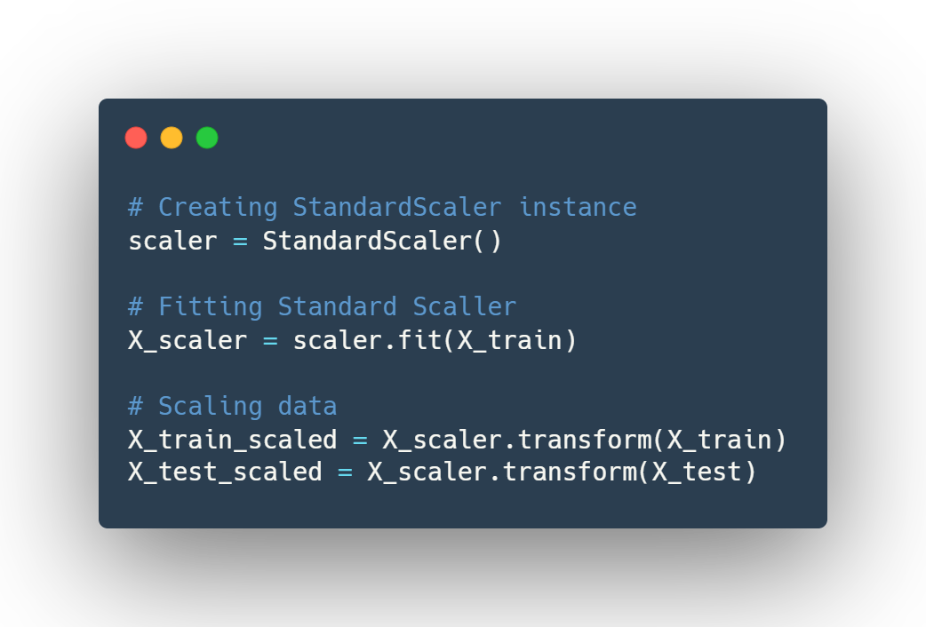
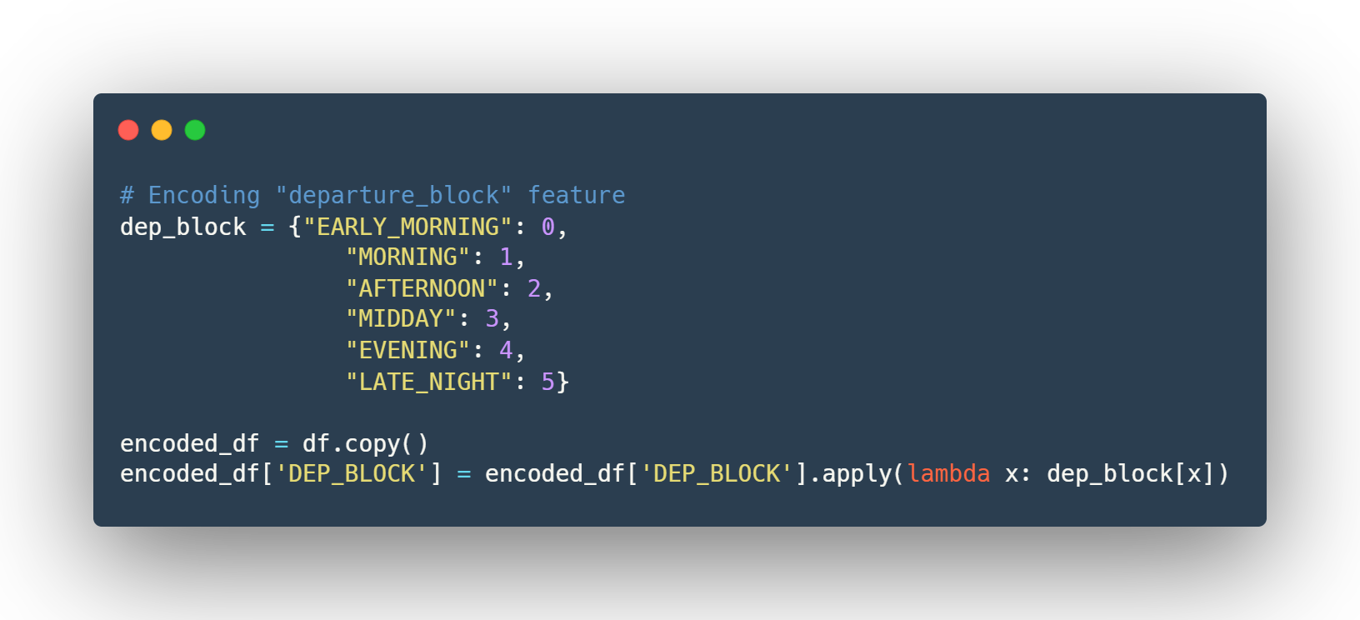
Encoding and Scaling
Notes:
John:
After selecting our feature there was still some data preprocessing which had to occur. As some of the columns in the working table contained items like airport names and other non-numerical values, these columns had to be encoded. In order for the results of the model to be more cohesive the team decided to custom encode the following variables: DEP_BLOCK, CARRIER_NAME, DEPARTING_AIRPORT and our target feature DEP_DEL15.The left screenshot is a sample of our code for custom the custom encoding.
As testing progressed, and our seniopr management was consulted, it was determined that in order to better utilize the available resources within the Collab Notebook and to achieve better model fitting performance, the data in the encoded dataframe had to be scaled. The scaling was achieved utilizing scikit-learn's standard scaler. Below is a sample of some of the standard scaling code:

Slide 10
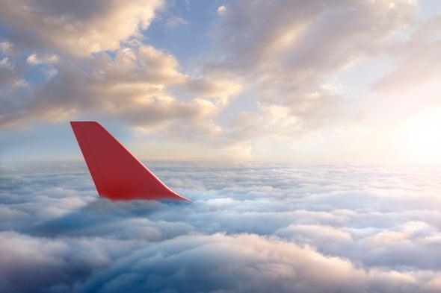
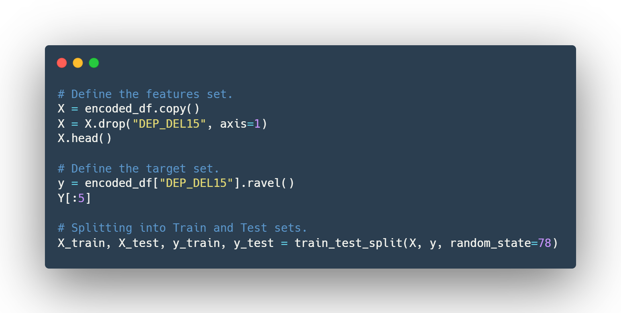
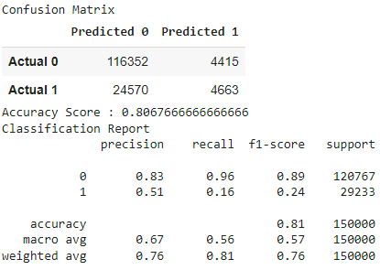
Model training and Testing
Confusion Matrix
Notes:
John:
Training and testing:
In general we attempted to establish a standardized and repeatable process so we utilized a similar training and testing approach for all of the models we tested.
The feature sets were defined by defining an x variable which contained a copy of the encoded dataframe. We then dropping the target feature from the dataframe and then the target set was defined as a Y variable containing our targeted feature.
Finally, the data was split into 2 sets - a Training set and a Testing set, and a 80/20 (training/testing) split was used across all models.
Finally we fit the model using the classifier.fit function, made our predictions, and generated confusion matrixes’.
The Confusing Matrix
The results of the predictions were a bit surprising to us. As you can see from the confusion matrix (Predicted 0 on time :Recall, f-1 score), our models, while overfitted, were actually quite successful in predicting on time departures.
This the opposite of what we intended to predict initially.
We attempted to address these issues by further attempting a neural network model, however as many of our TA’s and Stanley mentioned during many of our class session, the data can only tell us what the data tells us.
Colab Link: https://colab.research.google.com/drive/1sylYEcRKJAt4qQ6KycAd0af2Be5_Hwgv

Slide 11
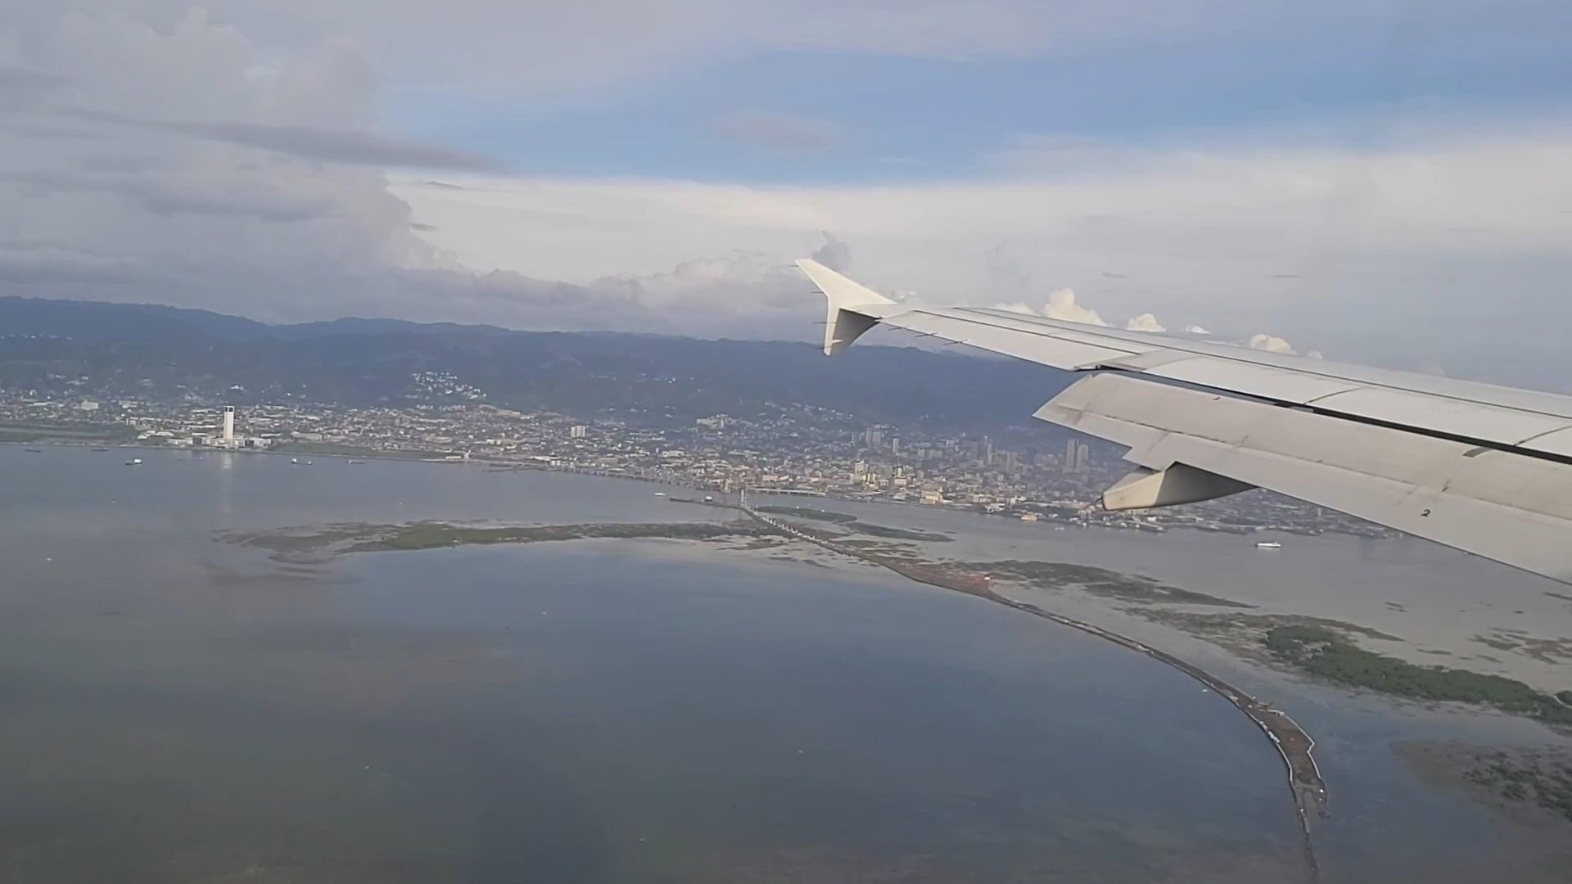
Results of the Analysis and Dashboard
Notes:
Transition to Dashboard: https://public.tableau.com/app/profile/hernan.e.cortes/viz/final_project_before/b_Dash?publish=yes

Slide 12
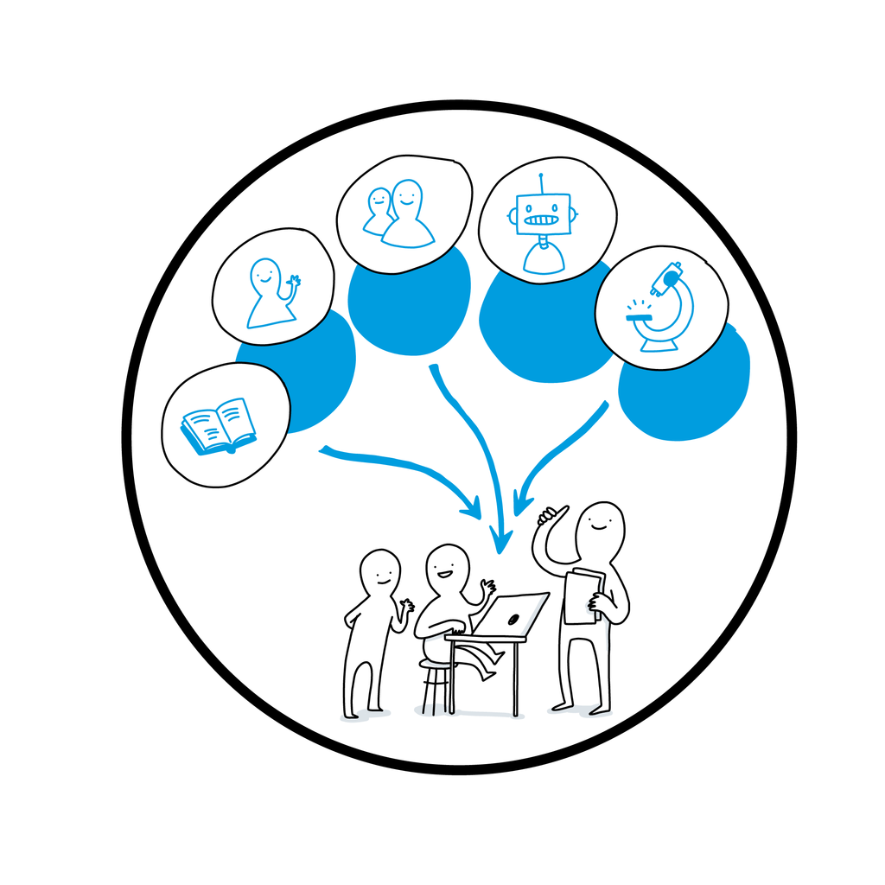
Notes:
As a team we are confident we have taken the most appropriate steps to complete our model and analysis given our experience, we wouldn’t have done anything differently to accomplish our project.
What’s next for our model?
We see different applications for our model based on the end user. We could have passengers or consumers as an end user, or an airline as an end user.
Integrate machine learning model into existing travel applications for the consumer to know whether they can expect the flight they are choosing to be on time
Create our own app with value-added features for the consumer or the airline https://framer.com/share/iTravel--7JIH18eeD4NImmHVy5XL/UYYYPE678?editor=1#TCCKSsQH6
Coerce airlines into avoiding delays as the consumer will avoid their flight if they consistently get a delay result
Use the machine learning model predictions to create a dashboard for the airlines to forecast potential cost associated to delays
It is estimated that it costs airlines about $74 per minute for delays, with this model, an airline can forecast the potential delay and set procedures in place to minimize the delays for cost-savings and passenger satisfaction

Slide 13

Notes:
From fist to five, how comfortable do you feel with this topic?
On behalf of my team, I would like to thank you for your time, and we hope you have enjoyed our team’s project.

Slide 14

Notes:
We will open up for any questions you may have.

